Slide 1

Tumours of central nervous system and Increased intracranial pressure
Dr H Silva
Dept of Pathology

Slide 2
Learning outcomes
Classify CNS tumours.
Outline the morphology of common tumours of the CNS.
Name the causes of raised ICP.
Outline the effects of raised ICP.

Slide 3
Tumours of the central nervous system

Slide 4
Pathogenesis
Majority unknown
Genetic alterations
Associated with syndromes (rare)
Neurofibromatosis - Ependymoma
Tuberous sclerosis
Von-Hippel Lindau syndrome
Immunosuppression - CNS lymphoma
Chemicals
Viruses
Radiation

Slide 5
CNS tumours
There are no known premalignant conditions.
The majority of these are primary tumors.

Slide 6
clinical course of a patient with a brain tumor is strongly influenced by patterns of growth and location.
Even the most highly malignant gliomas rarely metastasize outside the CNS.
Tumors are able to spread through the CSF.
Notes:
Tumors are able to spread through the CSF if they encroach upon the subarachnoid space, and thus may be associated with implantation along the brain and spinal cord at a distance from the original tumor site.

Slide 7
Classification according to the location
Supratentorial tumours
Common in adults
Infratentorial tumours
Common in children

Slide 8
Tumours of the CNS
Primary tumours Metastatic tumours
Neuroepithelial Others
tissue origin Origin- Peripheral nerves, meninges, hamopoietic tissue, Germ cells

Slide 9
Tumours of Neuroepithelial origin
Glial tissue (commonest)
- Astrocytoma
- Oligodendroglioma
- Ependymoma
Choroid plexus
- Papilloma
- Carcinoma
Primitive neuroectodermal
- Medulloblastoma

Slide 10
Other tumours of the CNS
Meninges - Meningioma
Hamopoietic tissue - Lymphoma
Germ cell tumours
Sellar region tumours - Craniopharyngioma
Peripheral nerves - Schwannoma, neurofibroma

Slide 11
CNS tumour classification
Incorporate histologic and biological features, combined with newer molecular analyses.
Currently used is the World Health Organization
(WHO) classification.
Beyond the scope of this lecture!

Slide 12
Gliomas
The most common group of primary brain tumors.
Include
Astrocytomas
Oligodendrogliomas
Ependymomas.

Slide 13
Origin of glial tumours
These arise from a progenitor cell that preferentially differentiates down one of the cellular lineages.
It is no longer thought that these tumors derive from their specific, mature cell types (astrocytes, oligodendrocytes, and ependymal).

Slide 14
Astrocytoma
Usually found in the cerebral hemispheres.
They may also occur in the cerebellum, brainstem, or spinal cord.
Often in the fourth to sixth decades.

Slide 15
WHO Grading- Infiltrating Astrocytomas
Diffuse astrocytoma (grade II/IV)
Anaplastic astrocytoma (grade III/IV)
Glioblastoma (grade IV/IV).
There are no WHO grade1 infiltrating astrocytomas.
(Grade 1 is confined to localized non infiltrating tumours.)

Slide 16
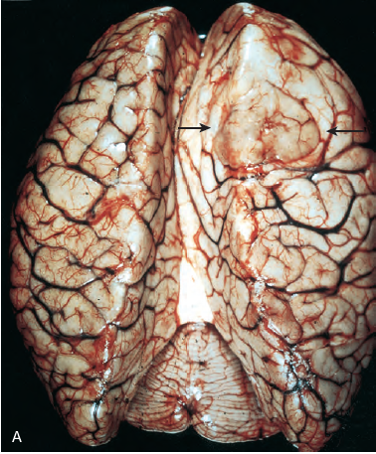
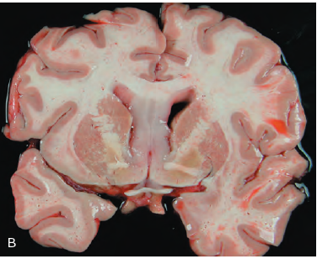
Diffuse astrocytoma.
A, The right frontal tumor has expanded gyri, which led to flattening (arrows).
B, There is bilateral expansion of the
septum pellucidum by gray, glassy tumor.

Slide 17
Diffuse astrocytomas
Macroscopy
Poorly defined, gray, infiltrative tumors that expand and distort the invaded brain.
Size range from a few centimeters to large lesions.
The cut surface of the tumor is firm , soft or gelatinous.
Cystic degeneration may be seen.

Slide 18
Microscopy
Cellular density is greater than normal white matter.
Between the tumor cell nuclei there is an extensive felt work of fine, astrocytic processes that create a fibrillary background appearance.
Nuclear pleomorphism.
The transition between neoplastic and normal tissue is indistinct.

Slide 19
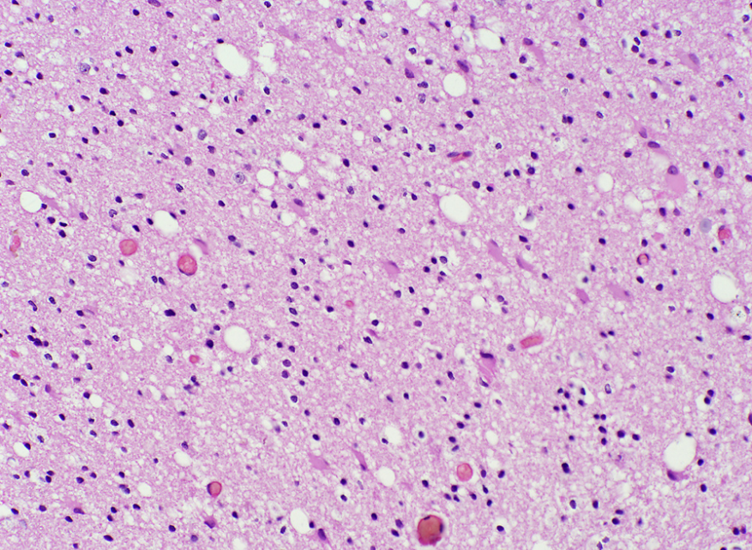
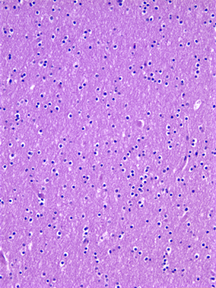
cellular density is greater than normal white matter.
fibrillary background appearance.
Diffuse astrocytoma
Normal white matter
Difficult to differentiate!

Slide 20
WHO Grading- infiltrating Astrocytomas
Diffuse astrocytoma (grade II/IV)
Anaplastic astrocytoma (grade III/IV)
Glioblastoma (grade IV/IV).

Slide 21
Anaplastic astrocytomas
Microscopy
A more densely cellular and greater nuclear pleomorphism.
Mitotic figures are often observed.

Slide 22
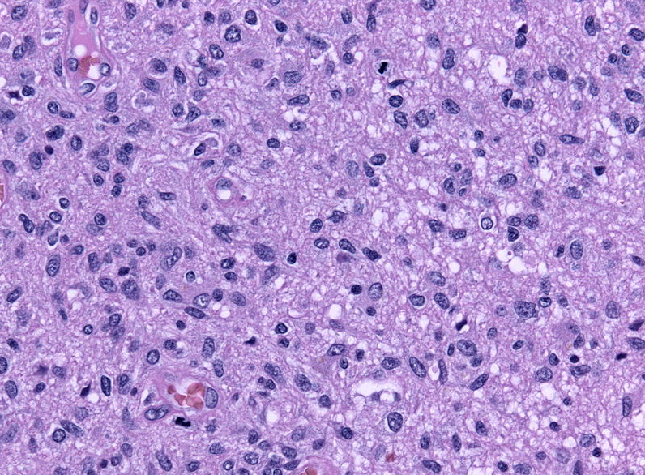
Anaplastic astrocytomas
Microscopy
A more densely cellular and greater nuclear pleomorphism.
Mitotic figures are often observed.

Slide 23
Glioblastoma
Previously called glioblastoma multiforme(GBM)
variation in the appearance of the tumor from region to region.
(Some areas are firm and white, others are soft and yellow due to necrosis, and some areas show cystic degeneration and hemorrhage.)

Slide 24
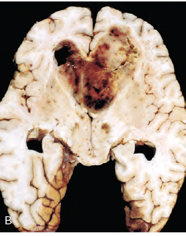
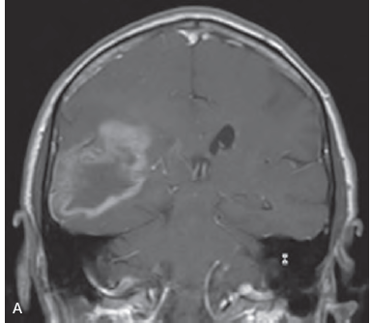
A) CT image shows a large mass in the right parietal lobe with “ring” enhancement.
B) Glioblastoma appearing as a necrotic, hemorrhagic, infiltrating mass.

Slide 25
Glioblastoma
Microscopy
Similar to anaplastic astrocytoma with the additional features.
necrosis
vascular/endothelial cell proliferation.

Slide 26
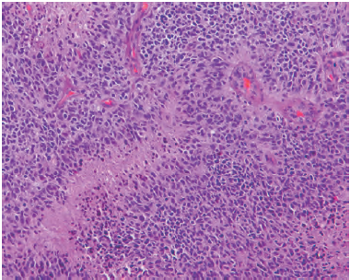
Glioblastoma.
pseudo-palisading of malignant nuclei and endothelial cell proliferation.

Slide 27
Pilocytic Astrocytoma
Distinguished from the infiltrating astrocytomas by their gross and microscopic appearance and supported by the differences in molecular signatures.
Relatively benign behavior.(WHO grade1)
They typically occur in children and young adults.

Slide 28
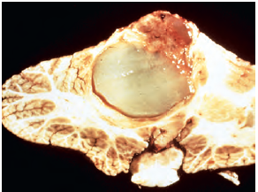
Macroscopy
Often cystic.
If solid, it may be well circumscribed or, less Frequently infiltrative.

Slide 29
Pilocytic astrocytoma- Microscopy
Tumors are often biphasic, with both loose “microcystic” and fibrillary areas.
Rosenthal fibers and eosinophilic granular bodies characteristic.
Show limited infiltration of the surrounding brain.

Slide 30
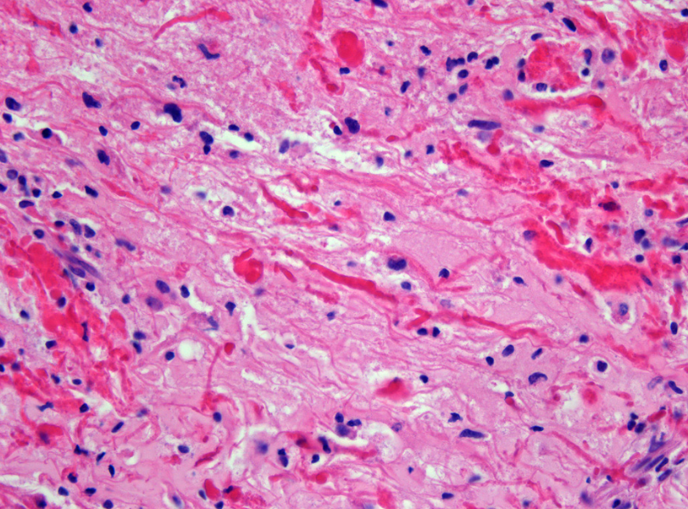
Rosenthal fibers
Pilocytic astrocytoma

Slide 31
Oligodendroglioma (WHO grade II)
These are infiltrating gliomas comprised of cells that resemble oligodendrocytes.
Constitute 5% to 15% of gliomas
Most common in the fourth and fifth decades.
Mostly in the cerebral hemispheres, with a predilection for white matter.

Slide 32
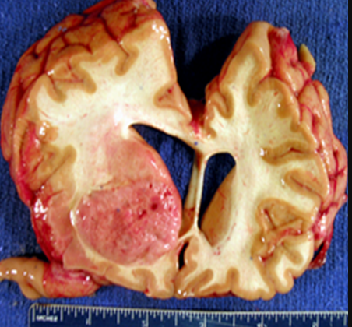
Macroscopy
well circumscribed, gelatinous, gray masses, often with cysts, focal hemorrhage, and calcification.
Notes:
Relatively surcumscribed

Slide 33
Microscopy
The tumors are composed of sheets of regular cells with spherical nuclei containing finely granular chromatin (similar to normal oligodendrocytes) surrounded by a clear halo of vacuolated cytoplasm.
Contains a delicate network of anastomosing capillaries.
Calcification, present in 90% tumours

Slide 34
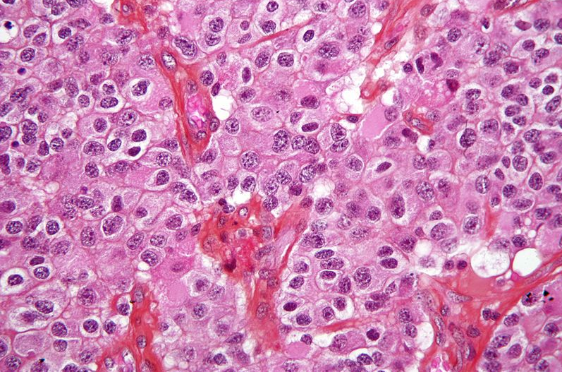
oligodendroglioma
sheets of regular cells with spherical nuclei, surrounded by a clear halo of vacuolated cytoplasm.
Contains a delicate network of anastomosing capillaries.
Calcifications, present in 90% tumours.

Slide 35
Anaplastic oligodendroglioma
(WHO grade II/IV)
Characterized by a higher cell density, nuclear anaplasia, detectable mitotic activity, and necrosis

Slide 36
Ependymomas
Often arise next to the ependyma-lined ventricular system.
In the first two decades of life they typically occur near the fourth ventricle and constitute 5% to 10% of the primary brain tumors in this age group.
In adults the spinal cord is the most common location.
Notes:
Often arise next to the ependyma-lined ventricular system.including the obliterated central canal of the spinal cord

Slide 37
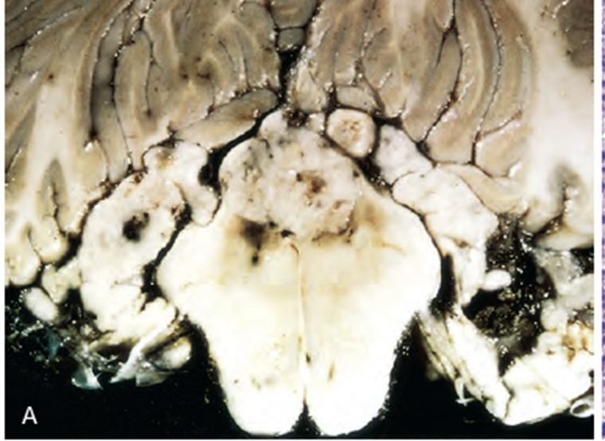

Slide 38
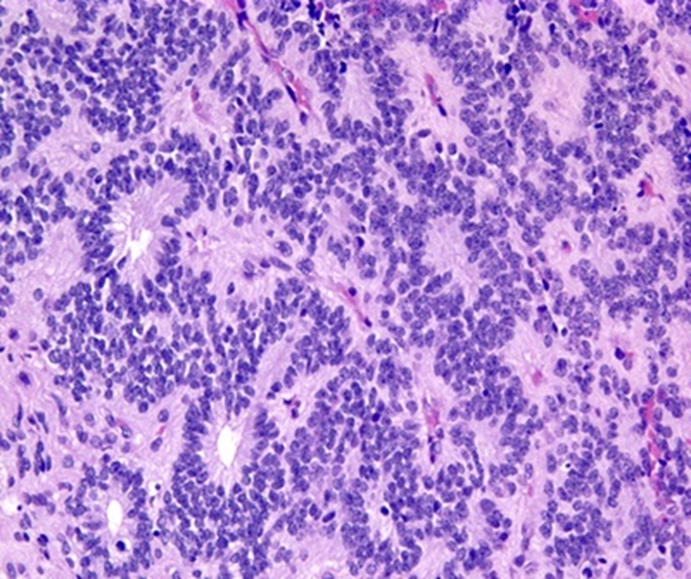
Ependymoma
Microscopy
composed of cells with regular, round to oval nuclei.
Between the nuclei there is a variably dense fibrillary background.
Tumor cells may form gland-like round or elongated structures (rosettes, canals and perivascular pseudorosettes).
Notes:
Tumor growing into the fourth ventricle, distorting, compressing, and infiltrating surrounding structures.

Slide 39
Anaplastic ependymomas (WHO grade III/IV)
Increased cell density
high mitotic rates
areas of necrosis
and less evident ependymal differentiation.

Slide 40
Choroid plexus papilloma
Common in children
Often in the lateral ventricles
Majority benign, but carcinomas are also there!
Cauliflower like growth pattern
Usually presents with hydrocephalus due to obstruction of the ventricular system by tumour or to overproduction of CSF.

Slide 41
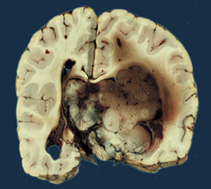
Choroid plexus papilloma - Macroscopy
Note:
Involvement of the left lateral ventricle
L

Slide 42
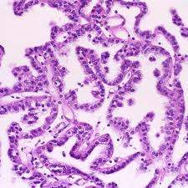
Choroid plexus papilloma - Microscopy
Note:
- Papillary growth pattern
Single layer of uniform cuboidal
to columnar cells

Slide 43
Medulloblastoma
Poorly differentiated tumour
Predominantly in children
Exclusively in the cerebellum (usually midline)
Rapidly growing
May occlude the flow of CSF Hydrocephalus
Extensive local infiltration with meningeal infiltration CSF seeding

Slide 44
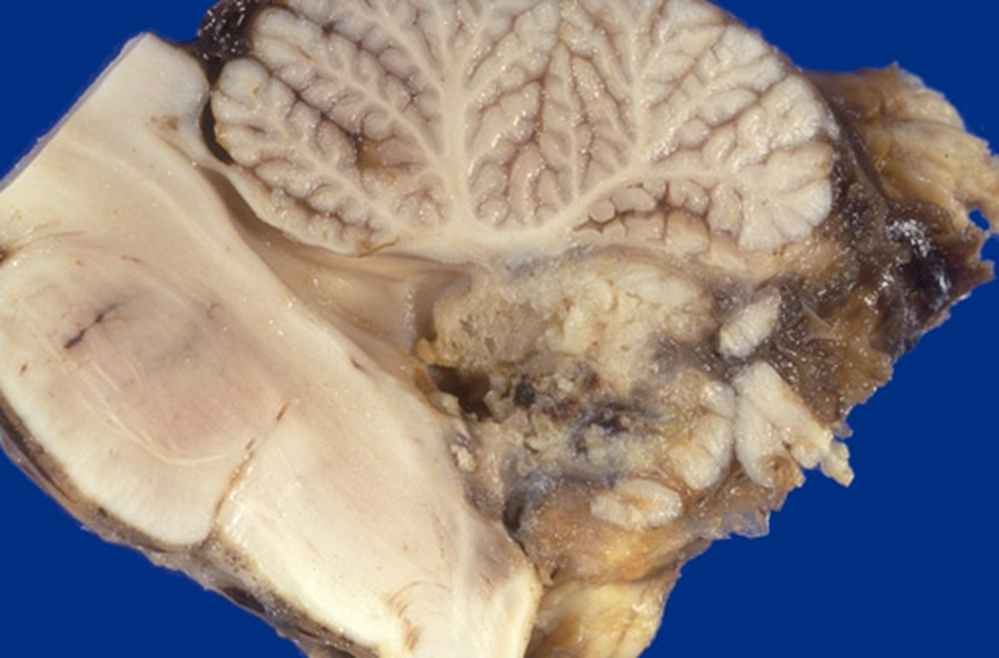
Medulloblastoma
Macroscopy
- often well circumscribed, grey and friable
- may involve the leptomeninges

Slide 45
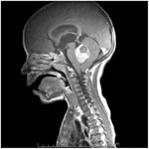
Medulloblastoma – CT scan

Slide 46
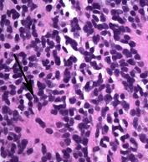
Medulloblastoma - Microscopy
Microscopy
Highly cellular sheets of
anaplastic cells

Slide 47
Other tumours of the CNS
Meninges - Meningioma
Haemopoietic tissue - Lymphoma
Germ cell tumours
Sellar region tumours - Craniopharyngioma
Peripheral nerves - Schwannoma, neurofibroma

Slide 48
Meningioma
Predominantly benign tumors of adults.
Usually attached to the dura.
Arise from the meningothelial cells of the arachnoid
Found along any of the external surfaces of the brain as well as within the ventricular system.
Usually solitary.

Slide 49
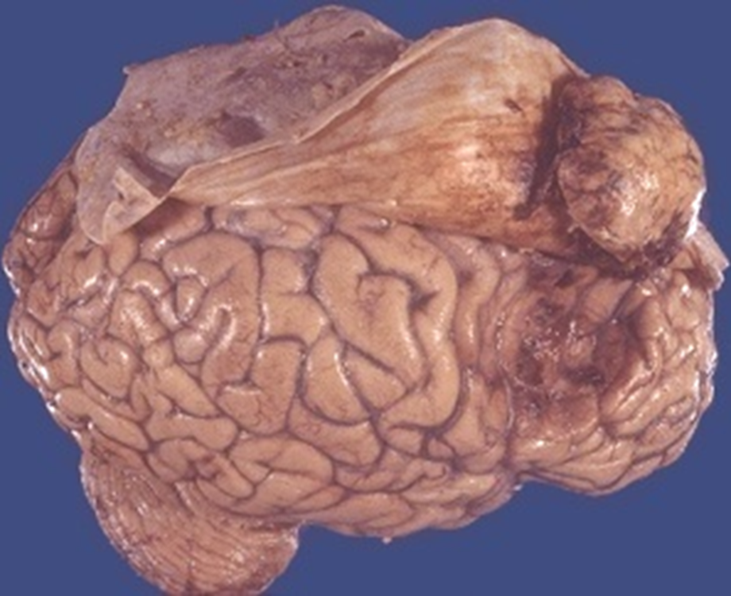
Meningioma macroscopy

Slide 50
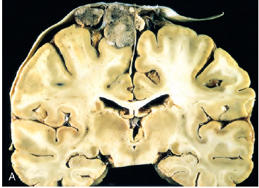
Parasagittal multilobular meningioma attached to the dura with compression of underlying brain.
Encapsulated by thin, fibrous tissue and may have a bosselated or polypoid appearance

Slide 51
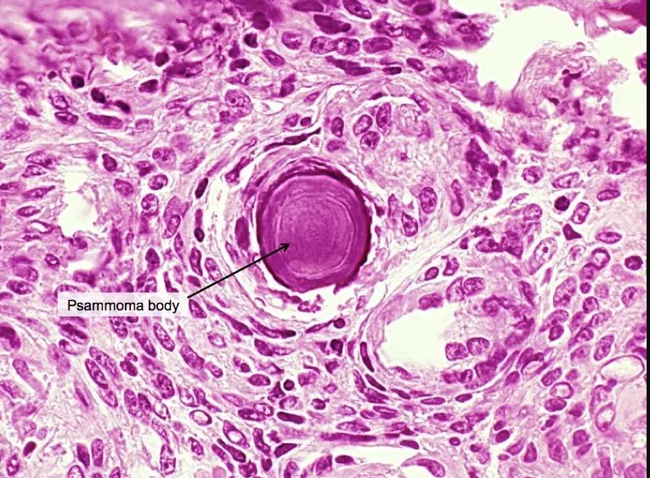
Meningioma microscopy
Medium sized epithelioid tuour cells form lobules and whorls.
Partly demarcated by thin fibrous septa.
Psammoma bodies can be seen.

Slide 52
Most meningiomas have a relatively low risk of recurrence (WHO grade I).
But there are atypical meningiomas(Grade11)
And anaplastic meningiomas(Grade111)
Various histologic patterns are observed, with no prognostic significance.(eg: meningothelial. Psammomatous, fibrous, transitional, sectretory etc)

Slide 53
Nerve sheath tumours
Schawannoma
Encapsulated
Cerebello pontine angle -8th cranial nerve
- acoustic neuroma
Neurofibroma
Non-encapsulated
Dorsal nerve roots of the spinal cord

Slide 54
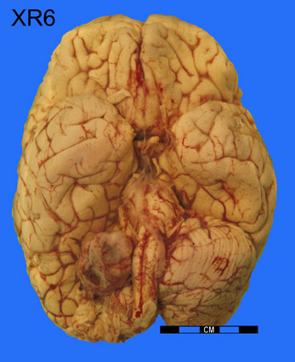
Acoustic neuroma

Slide 55
Germ cell neoplasms
Origin from aberrant migrating germ cells in midline (pineal and suprasellar regions)
Rare
Germinoma Teratoma (mature, immature, with malignant transformation)
Yolk sac tumour
Embryonal carcinoma
Choriocarcinoma
Mixed germ cell tumour

Slide 56
lymphoma
Primary CNS lymphoma (PCNSL) occurs in both immunosuppressed and immunocompetent individuals.
CNS may be involved in advanced systemic haemotolymphoid neoplasms.
Non Hodgkin Lymphoma is the most common
Notes:
CNS may be involved in advanced systemic haemotolymphoid neoplasms. NHL (e.g. Burkitt), Hodgkin disease, plasmacytoma or myeloma

Slide 57
Metastasis
Most are carcinomas
common primary sites are
lung, breast, skin (melanoma), kidney, and GIT
Usually multifocal
Have rapidly progressive symptoms.
Present clinically as mass lesions and may occasionally be the first manifestation of the cancer.

Slide 58
Clinical effects of CNS tumours
Clinical effects of intracranial neoplasms are mainly those of raised ICP
(headache, vomiting and papilloedema)
These are modified by anatomical location of the neoplasm (Refer and workout!)
There may be seizures, localizing signs, behavioral abnormalities, cognitive deficits and endocrinopathies……………………………………………
…………………………….

Slide 59
Summary

Slide 60
Raised Intra cranial pressure

Slide 61
Intracranial pressure- is the pressure exerted by the cranium on the brain tissue, cerebrospinal fluid (CSF), and the brain's circulating blood volume.

Slide 62
As the volume of the brain increases, CSF is displaced and the vasculature is compressed(ischemia) , leading to increasing pressure within the cranial cavity.
When this limit is exceeded cause brain herniation across the pressure gradient.

Slide 63
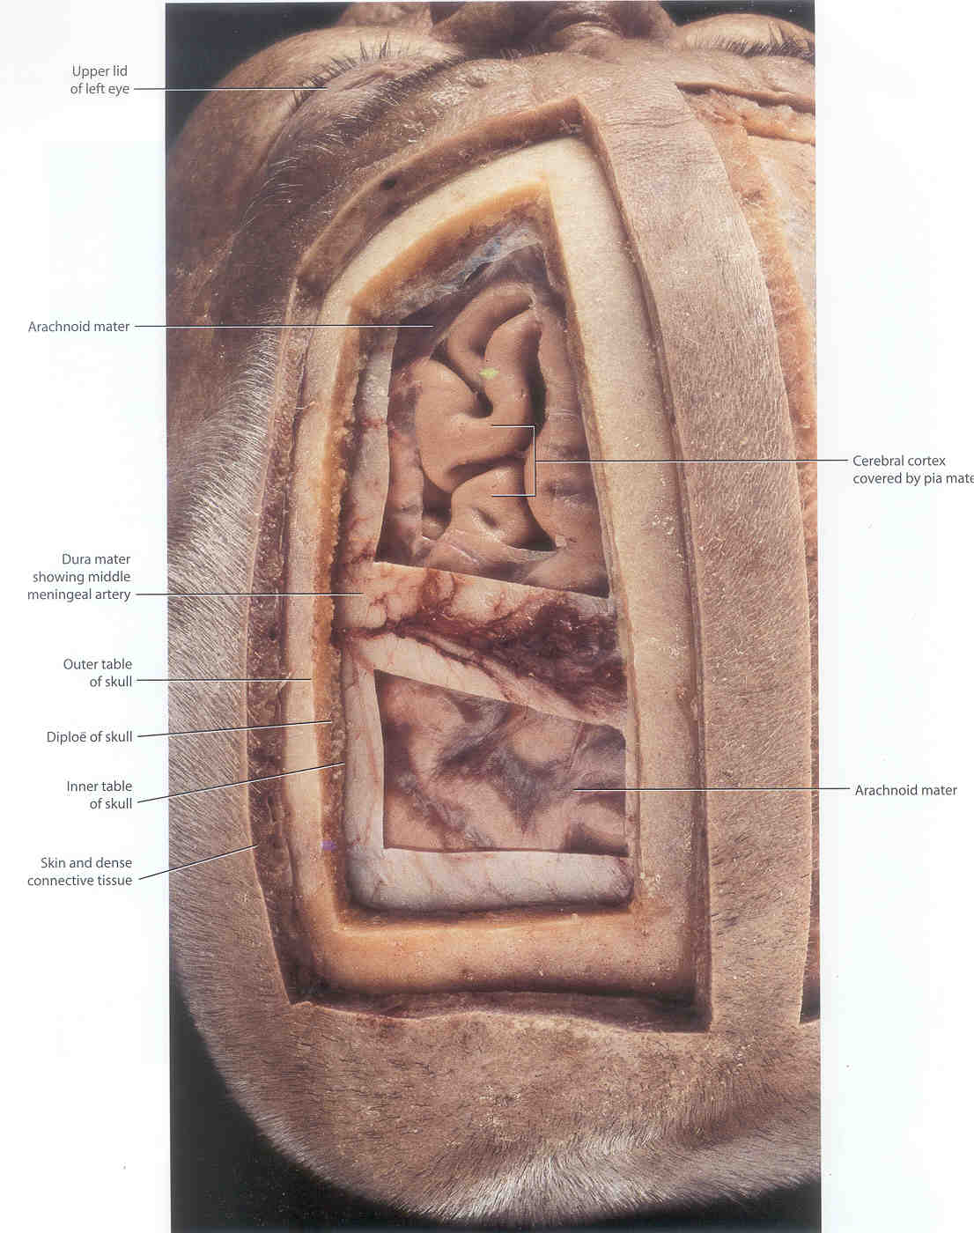

Slide 64
Intracranial contents
70% 15% 15%
Brain CSF Blood

Slide 65
Raised intracranial pressure
1) Space occupying lesions
Neoplasm
Abscess
Haemorrhages
2)Oedema – Diffuse / focal
Infarction
Infections
3) Obstructive hydrocephalus

Slide 66
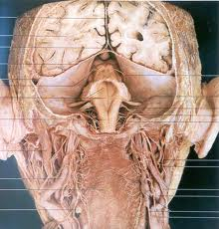
Falx cerebrei
Tentorium cerebrei
Posterior view

Slide 67
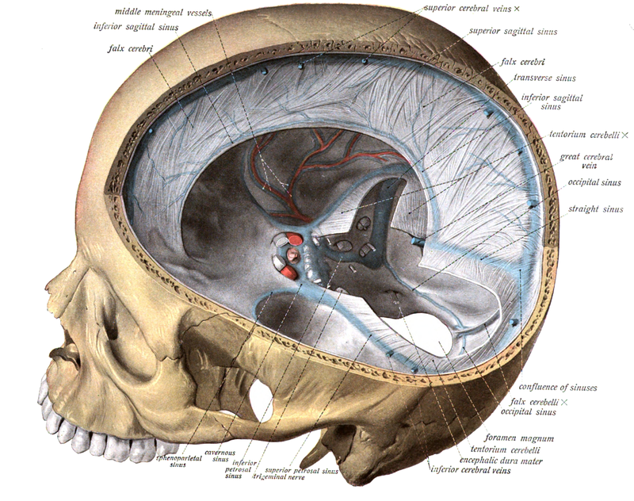
Falx cerebri
Tentorium cerebri

Slide 68
Cerebral edema(brain parenchymal edema)
Increased fluid leakage from blood vessels or injury to various cells in CNS
Hydrocephalus
Accumulation of excessive CSF with in the ventricular system impaired flow and resorption overproduction- tumors of choroid plexus
Herniation
Displacement of brain tissue past rigid dural folds or through openings in the skull because of ↑ ICP

Slide 69
Cranial compartment is incompressible, and the volume inside the cranium is a fixed volume.
Any increase in volume of one of the cranial constituents (blood, CSF, and brain tissue) must be compensated by a decrease in volume of another.

Slide 70
Raised intracranial pressure
Increase Compensatory changes
Brain volume - Reduced CSF space Maintain normal ICP
- Reduced blood volume
Critical phase
Distortion and displacement of the brain
Manifestation of clinical features

Slide 71
Effects of raised intracranial pressure
Narrowing of sulci
Flattening of gyri
Surface of the brain looks dry
Compression of the ipsilateral lateral ventricle
Shift of midline structures
Internal brain herniation
- Transtentorial hernia
- Subfalcine hernia
- Tonsilar hernia

Slide 72
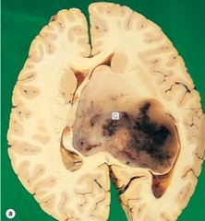
Macroscopy
Note:
Shift of midline structures
(interventricular septum, anterior cerebral arteries and the third ventricle)

Slide 73
Brain herniation
The cranial cavity is partitioned by the tentorium cerebelli and falx cerebri.
A part of the brain can be compressed by an extrinsic lesion (eg- subdural hematoma) or is expanded (eg-brain tumor, abscess).
This displaces (herniates) a part of the brain from one cranial compartment to another.
Herniation puts extreme pressure on parts of the brain and thereby cuts off the blood supply to various parts of the brain- it is often fatal.

Slide 74
Three major herniations can occur, either alone or in combination:
Subfalcial herniation
Uncal (transtentorial) herniation
Cerebellar tonsillar herniation.

Slide 75
Uncal/Transtentorial herniation
Herniation of the medial temporal lobe from the middle into the posterior fossa, across the tentorial opening/Incisura.
The uncus of the temporal lobe is forced into the gap between the midbrain and the edge of the tentorium.

Slide 76
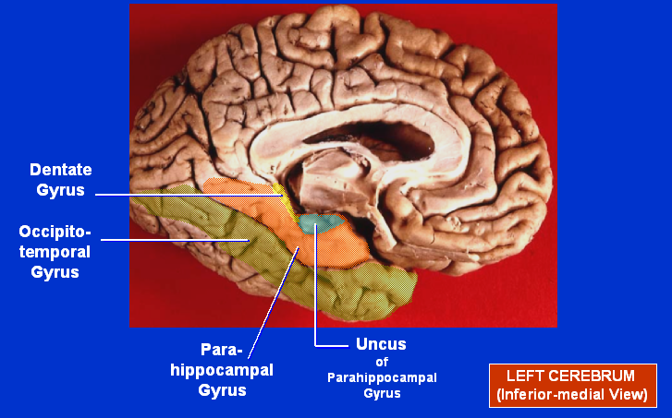

Slide 77
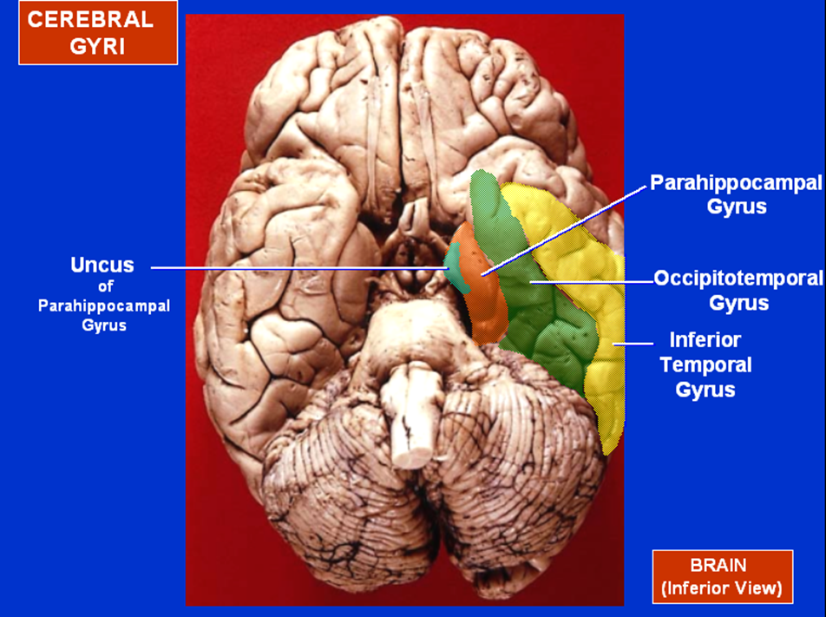

Slide 78
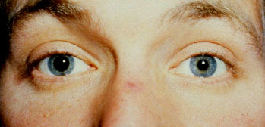
Transtentorial herniation clinical manifestations
Ipsilateral 3rd nerve compression
- Fixed dilated pupils
- Down and out position of eye
Posterior cerebral artery compression
Ischaemia of I/L visual cortex
duret haemorrahges
Brain stem compression
- Cardiorespiratory failure and death

Slide 79
The herniating uncus displaces the midbrain laterally.
The contralateral cerebral peduncle is compressed against the edge of the tentorium
Formation of a groove (Kernohan notch) and hemorrhage on the contralateral midbrain.
Cause paralysis on the same side as the primary lesion.
A false localizing sign!
Notes:
compression of the contralateral cerebral crus containing descending corticospinal and some corticobulbar tract fibers. This leads to Ipsilateral hemiparesis in reference to the herniation and contralateral hemiparesis with reference to the cerebral crus.

Slide 80
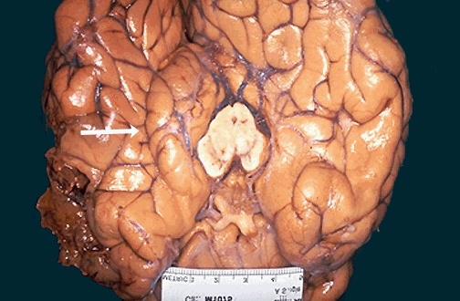
Left cerebral hemisphere
Note : - Swollen left cerebral hemisphere
- Herniation of the uncus of the hippocampus through the tentorium
- Groove on the mid brain (white arrow)

Slide 81
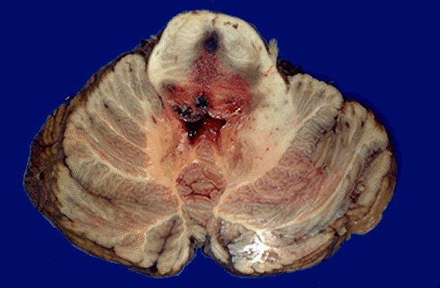
Duret haemorrhages

Slide 82
Sub falcine herniation
Displaces cingulate gyrus under the falx
Common with frontal lobe lesions
Compress the anterior cerebral arteries and its branches.
This can lead to abnormal posture, coma etc

Slide 83
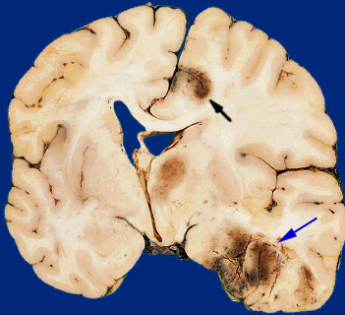
Subfalcine herniation
Herniation of cingulate gyrus
Secondary haemorrhagic infarct
Midline shift
L
Contusion of the inferior temporal lobe
Cingulate gyrus herniates through the free edge of the falx

Slide 84
Tonsilar herniation
Cerebellar tonsils move downward through the foramen magnum.
Possibly causing compression of the lower brainstem and upper cervical spinal cord.
Common with infratentorial expansile lesions.
Lead to brain stem compression and haemorrhage
- Cardiorespiratory failure and death.
Notes:
Can be dramatic if a lumbar puncture is done with an undiagnosed mass lesion

Slide 85
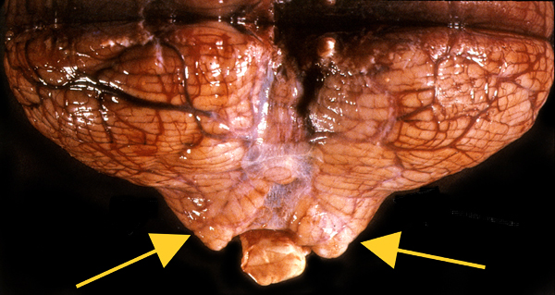
Tonsilar herniation
Note: Grooved cerebellar tonsils by compression against the foramen magnum (arrows)

Slide 86
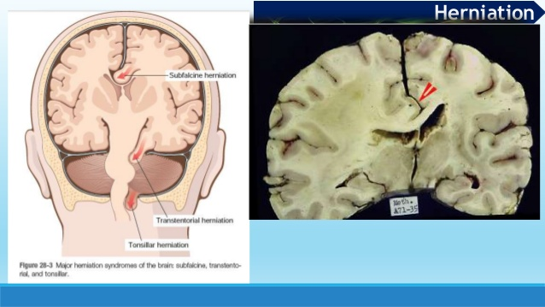

Slide 87
List the causes of raised intracranial pressure
Describe the effects of raised intracranial pressure
Give the clinical manifestations of raised intracranial pressure

